Slide 1

SQL ASSIGNMENT
SUMIT UPADHYAY

Slide 2
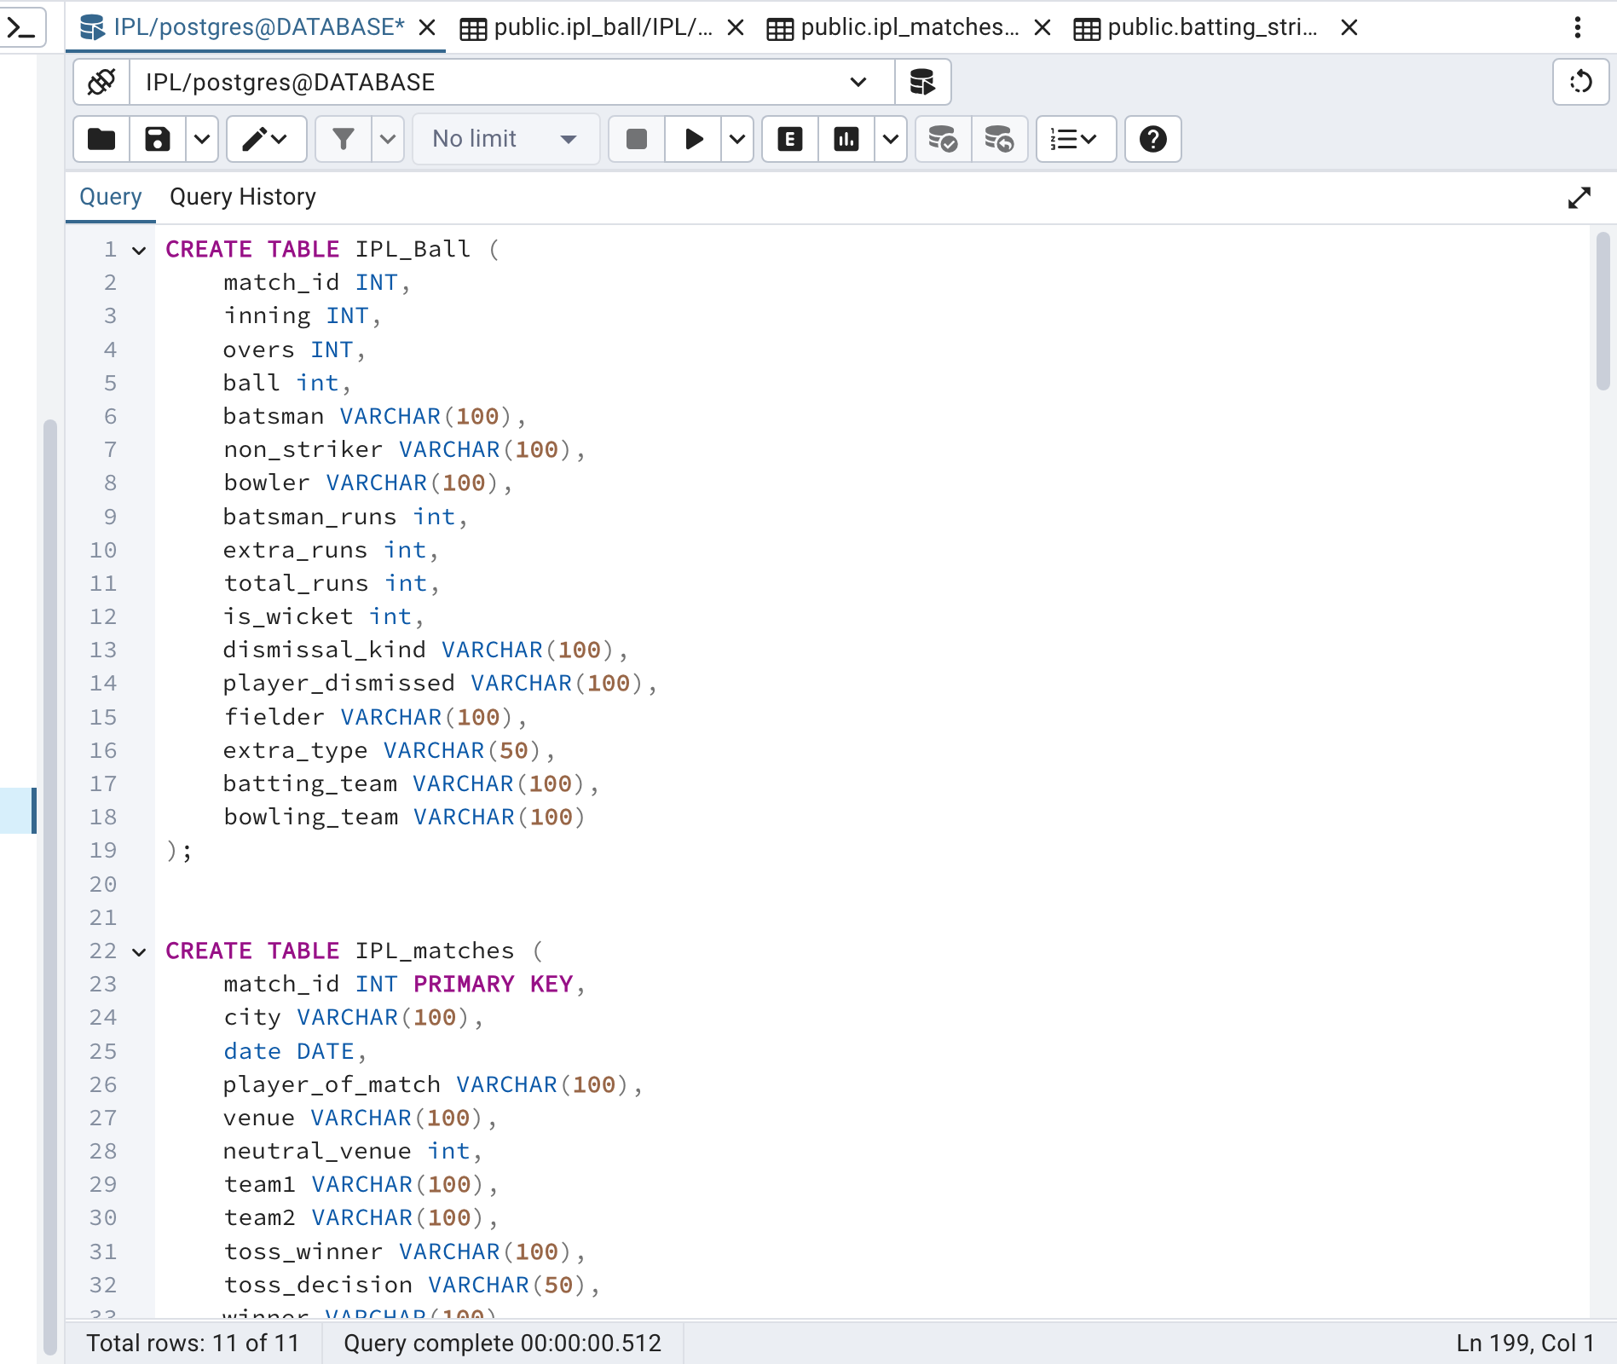
1ST I HAVE CREATED THE DB AND INSERTED THE CSV DATA IN IT

Slide 3
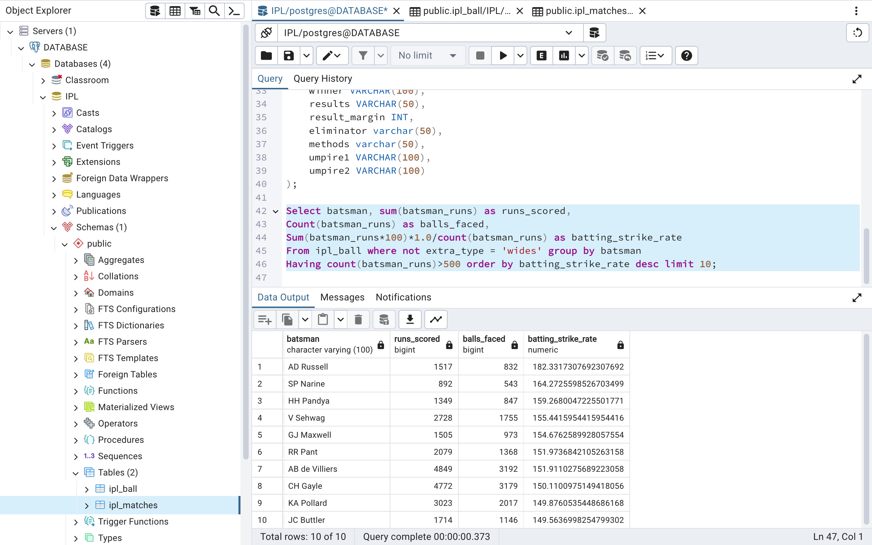
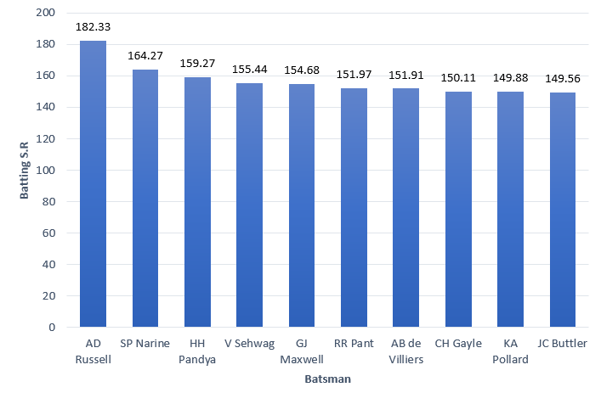
Your priority is to get 2-3 players with high S.R who have faced at least 500 balls. And to do that you have to make a list of 10 players you want to bid in the auction so that when you try to grab them in auction you should not pay the amount greater than you have in the purse for a particular player. (strike rate is total runs scored by batsman divided by number of balls faced but remember when extras type is 'wides' it is not counted as a ball faced neither counted as batsmen runs)

Slide 4
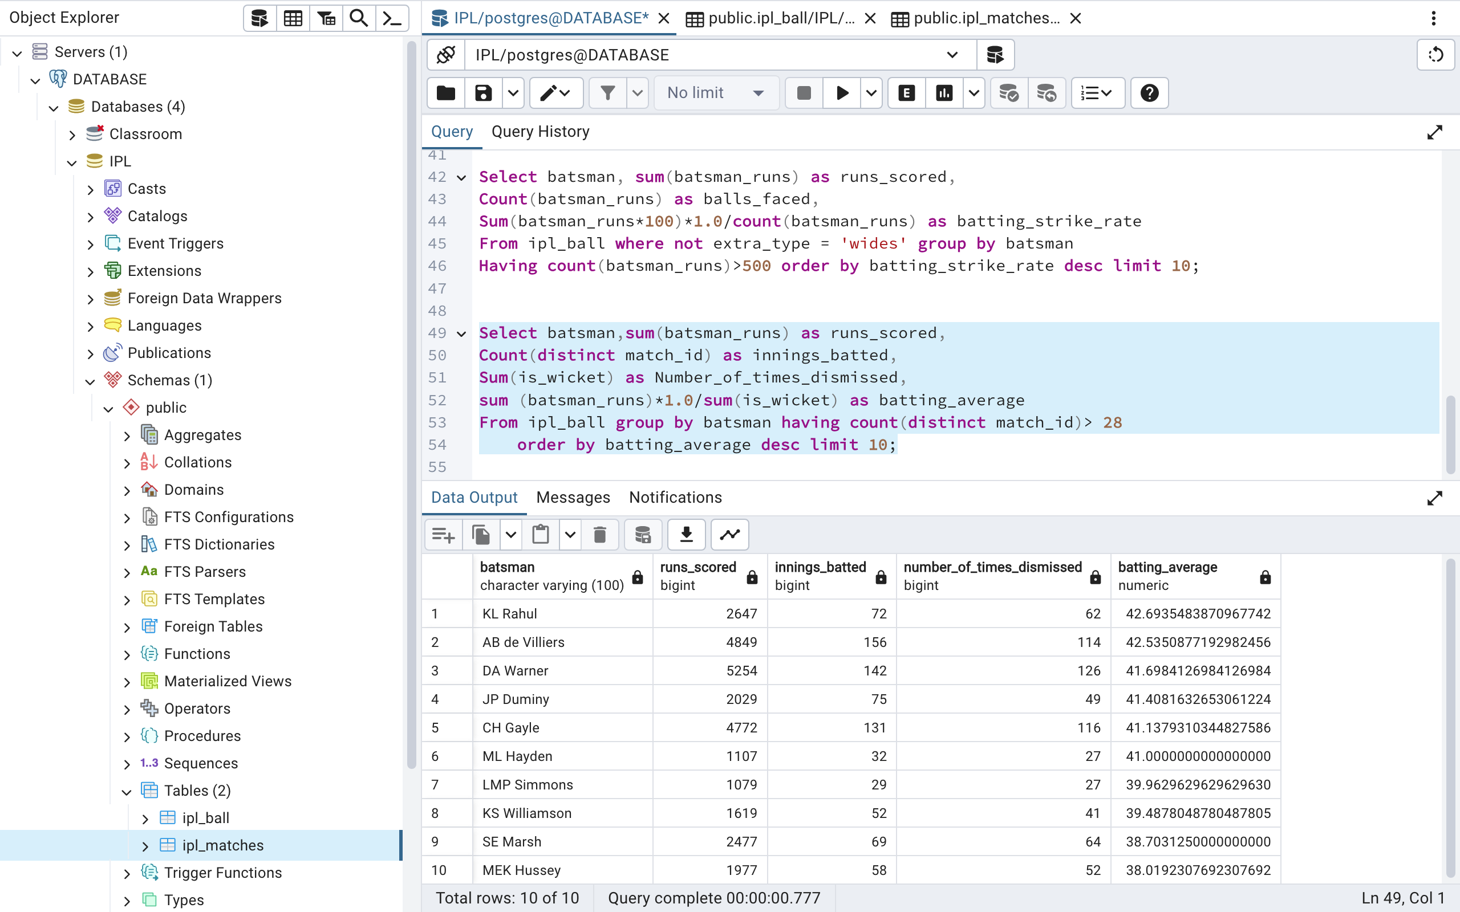
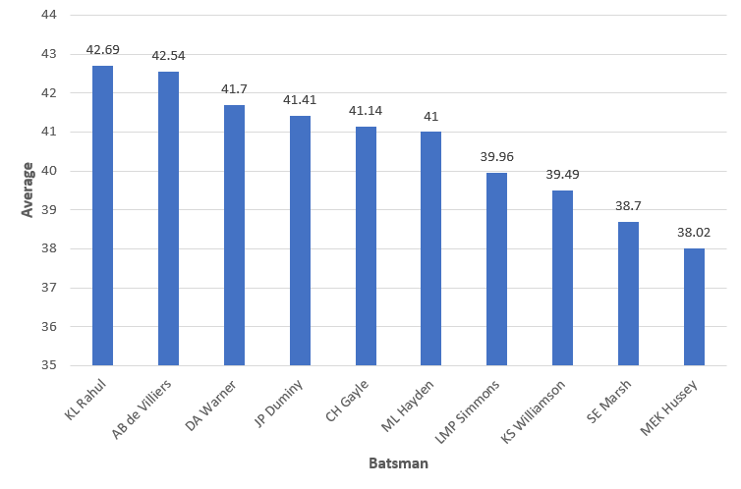
Now you need to get 2-3 players with good Average who have played more than 2 ipl seasons. And to do that you have to make a list of 10 players you want to bid in the auction so that when you try to grab them in auction you should not pay the amount greater than you have in the purse for a particular player.

Slide 5
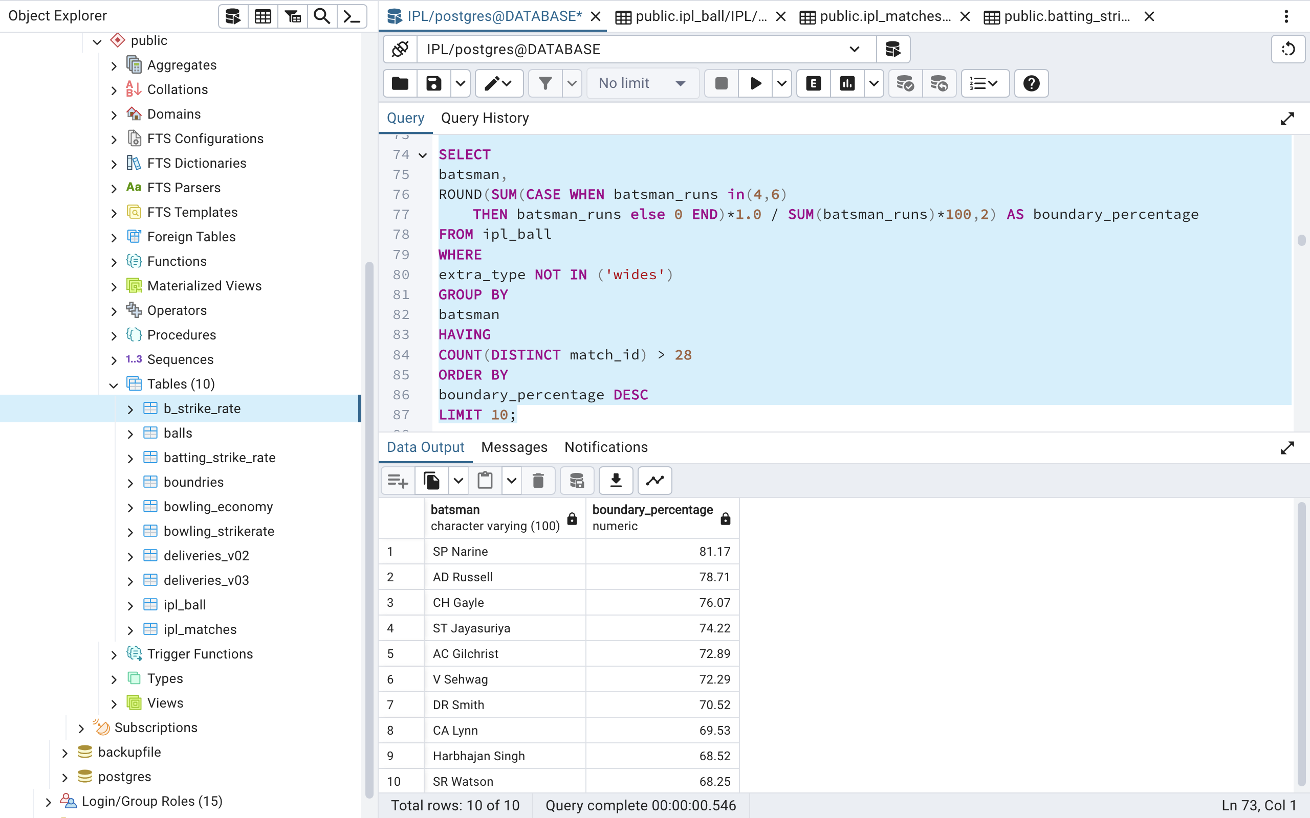
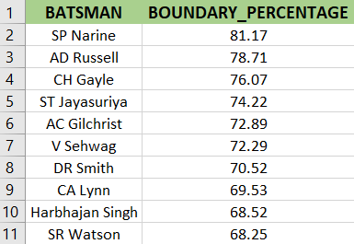
Now you need to get 2-3 Hard-hitting players who have scored most runs in boundaries and have played more the 2 ipl season. To do that you have to make a list of 10 players you want to bid in the auction so that when you try to grab them in auction you should not pay the amount greater than you have in the purse for a particular player.

Slide 6
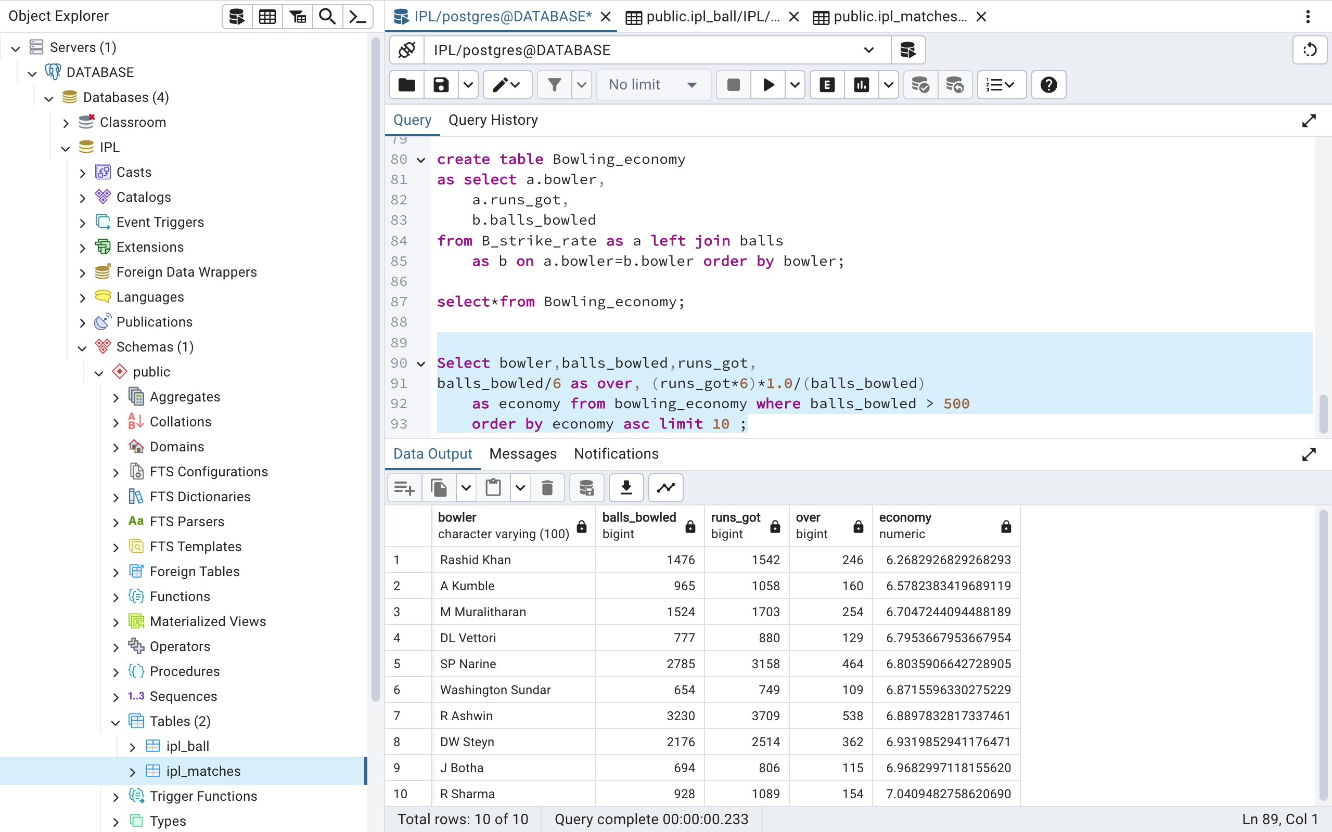
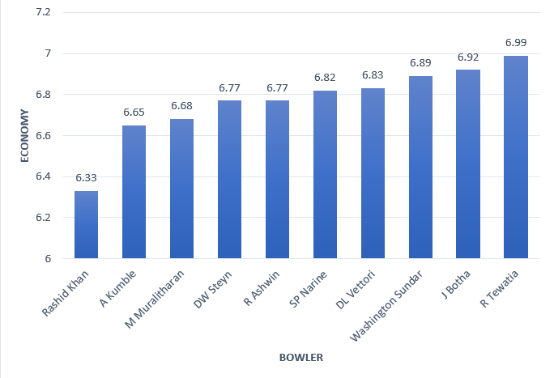
Your priority is to get 2-3 bowlers with good economy who have bowled at least 500 balls in IPL so far. To do that you have to make a list of 10 players you want to bid in the auction so that when you try to grab them in auction you should not pay the amount greater than you have in the purse for a particular player.

Slide 7
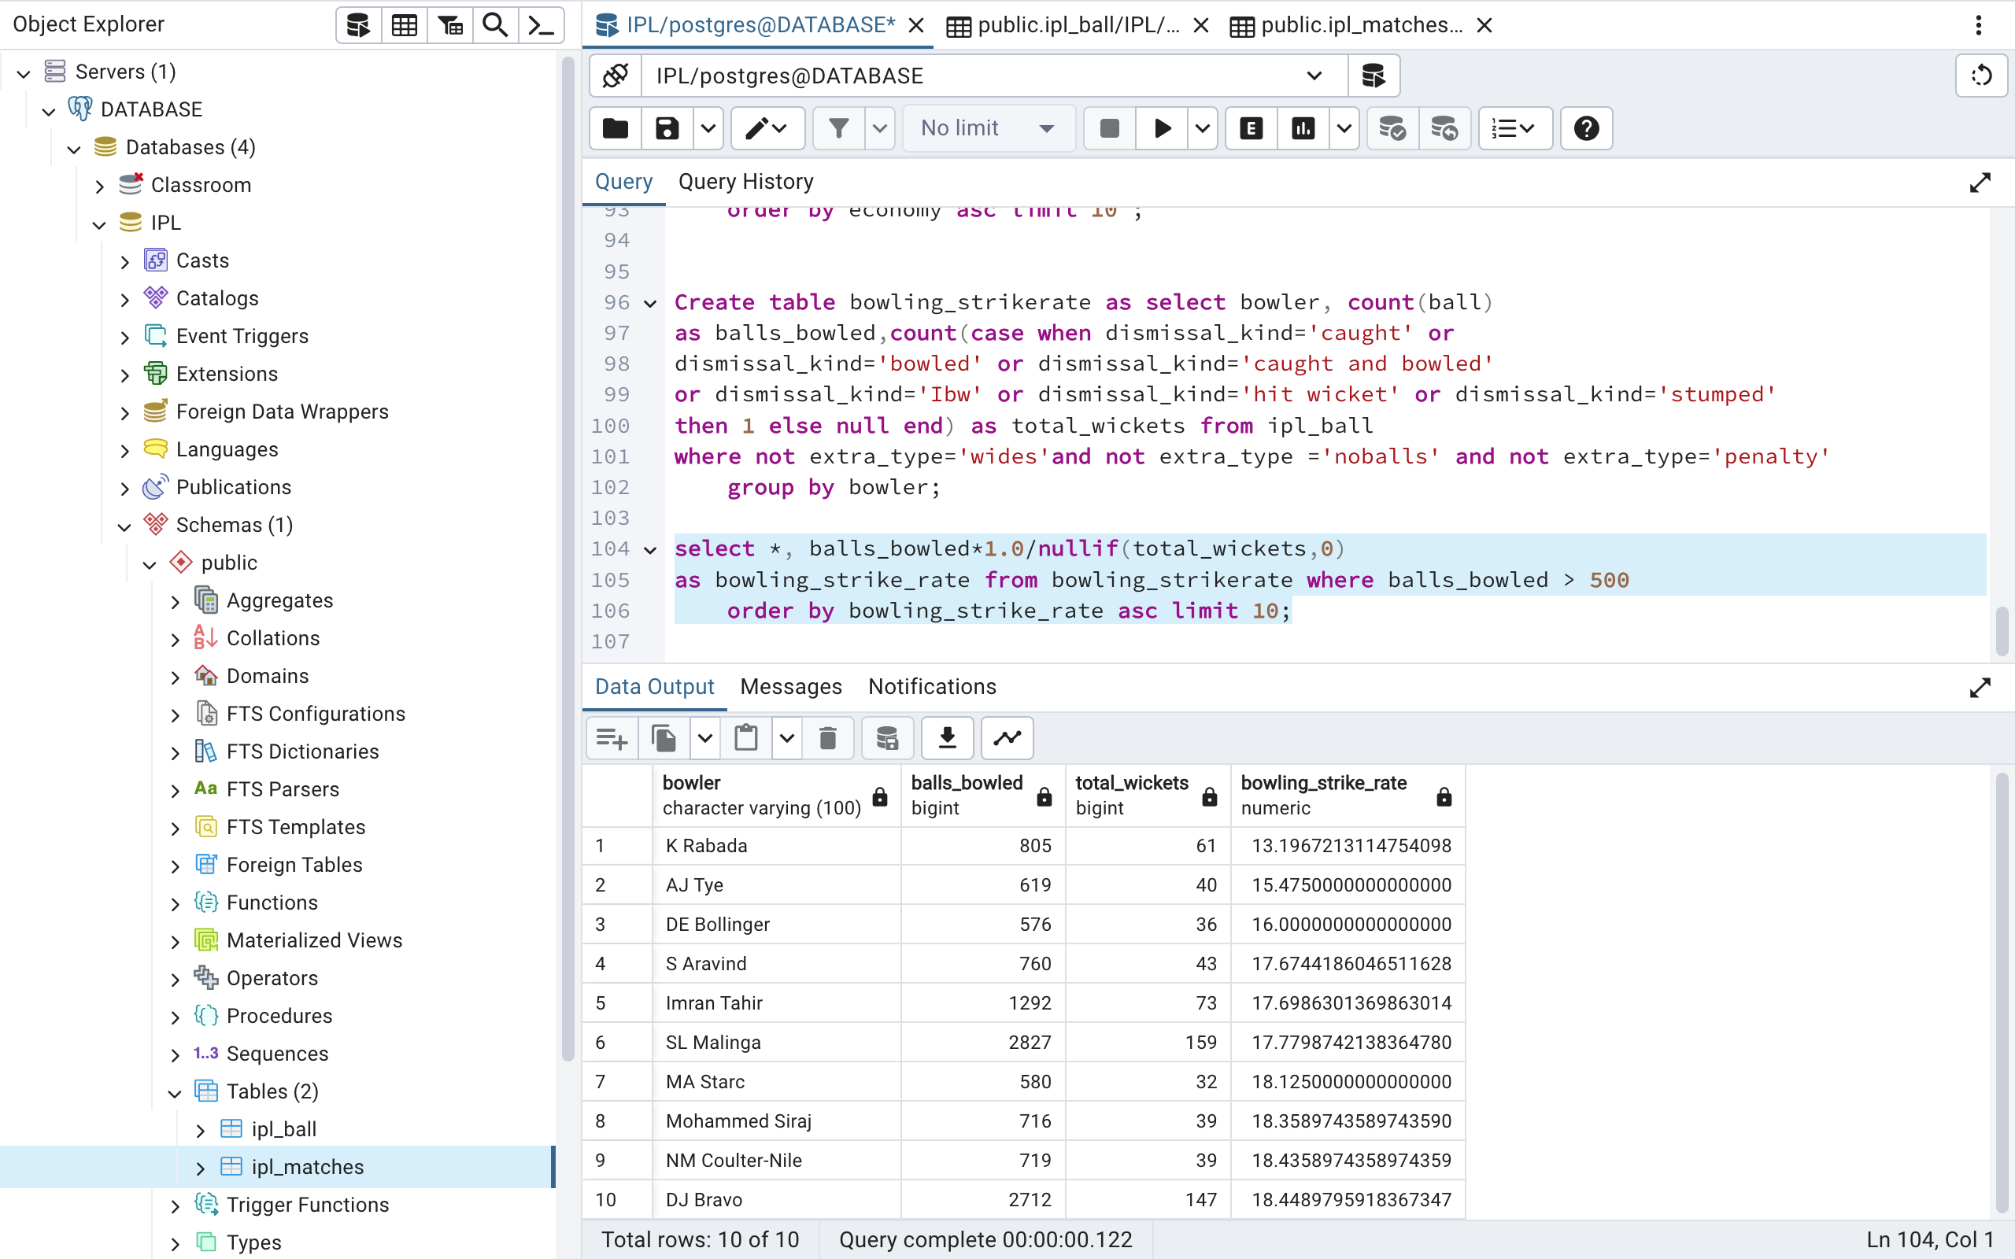
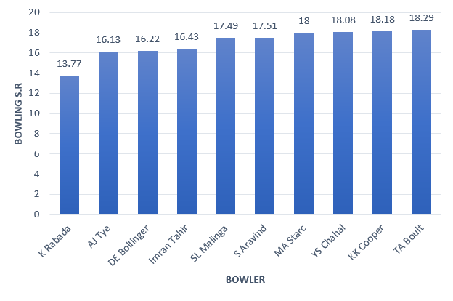
Now you need to get 2-3 bowlers with the best strike rate and who have bowled at least 500 balls in IPL so far.To do that you have to make a list of 10 players you want to bid in the auction so that when you try to grab them in auction you should not pay the amount greater than you have in the purse for a particular player.

Slide 8
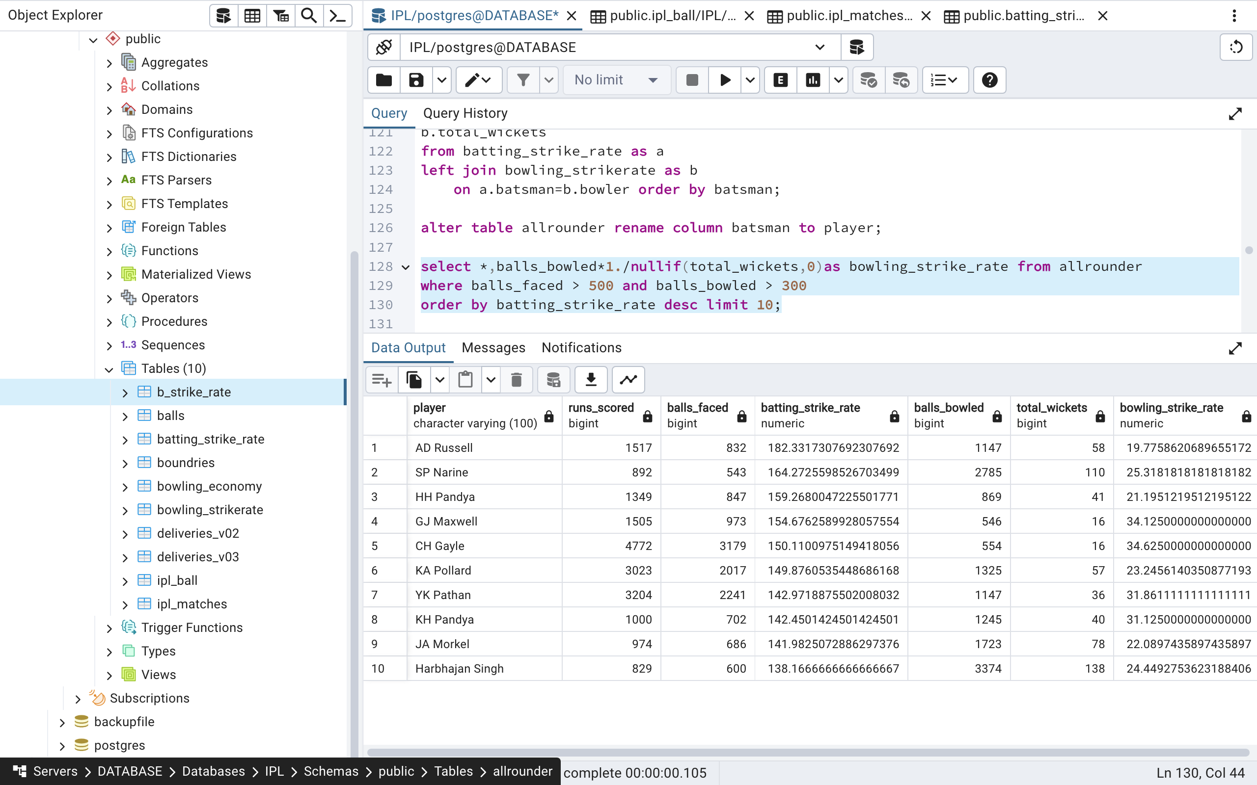
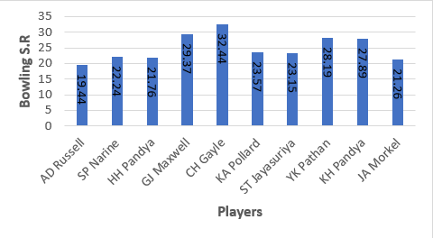
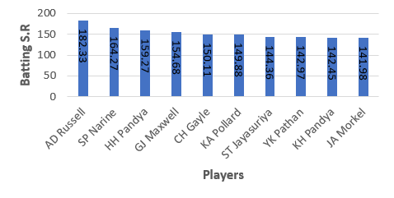
Now you need to get 2-3 All_rounders with the best batting as well as bowling strike rate and who have faced at least 500 balls in IPL so far and have bowled minimum 300 balls.To do that you have to make a list of 10 players you want to bid in the auction so that when you try to grab them in auction you should not pay the amount greater than you have in the purse for a particular player.

Slide 9
ADDITIONAL QUESTIONS

Slide 10
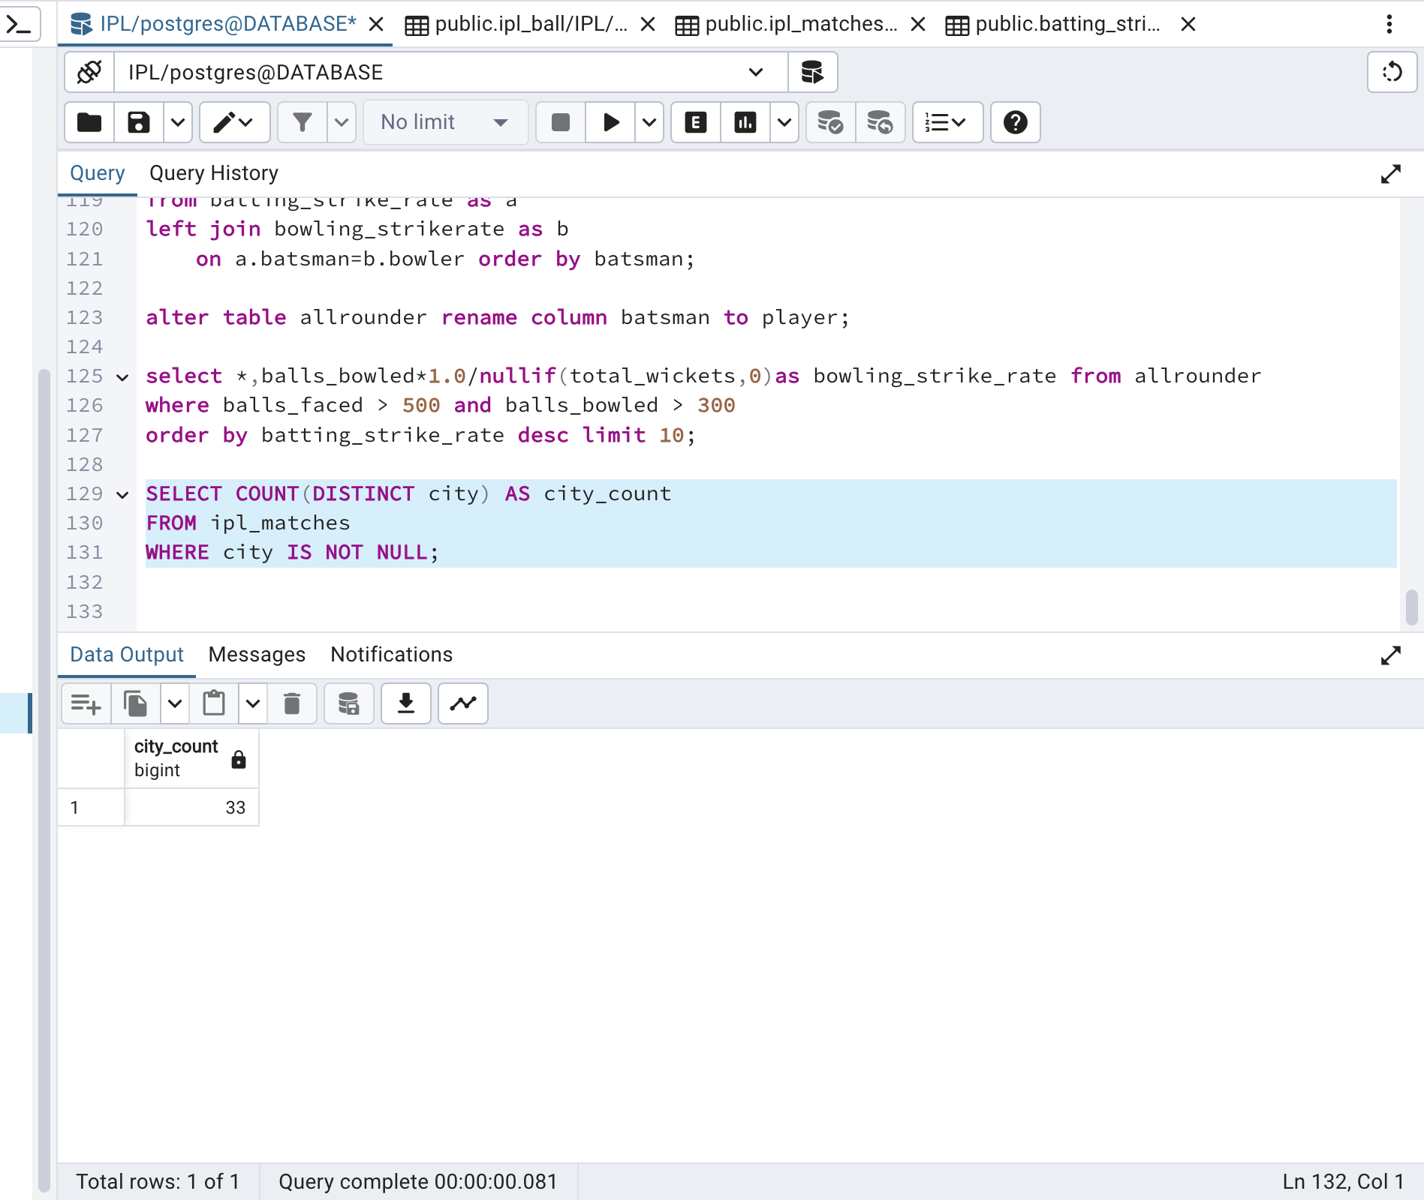
Get the count of cities that have hosted an IPL match

Slide 11
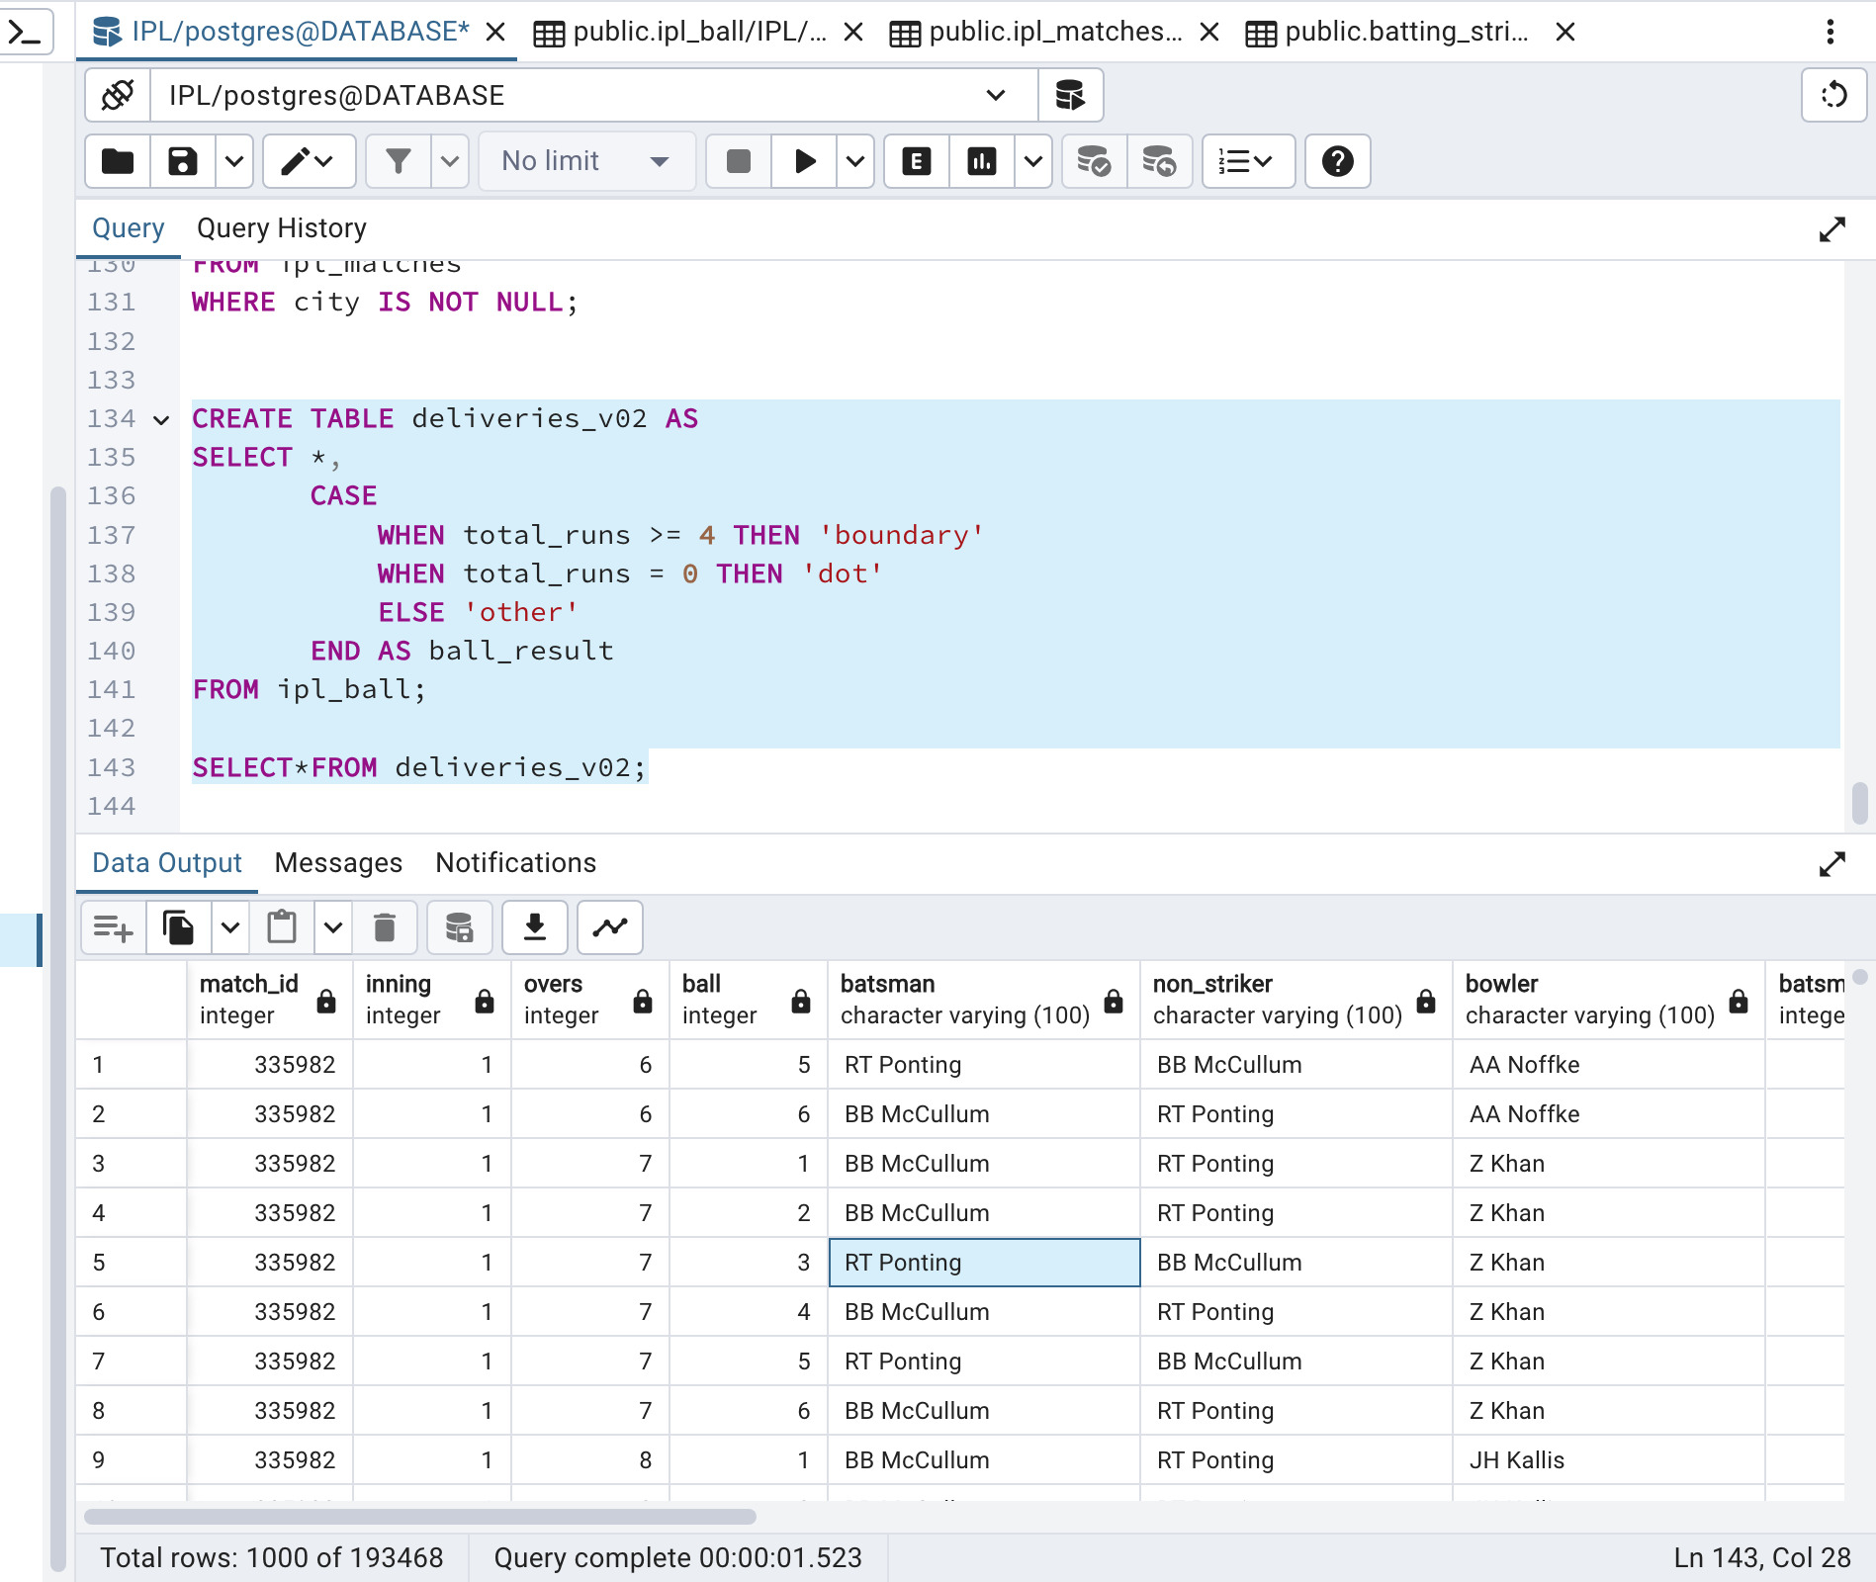
Create table deliveries_v02 with all the columns of the table ‘deliveries’ and an additional column ball_result containing values boundary, dot or other depending on the total_run (boundary for >= 4, dot for 0 and other for any other number)

Slide 12
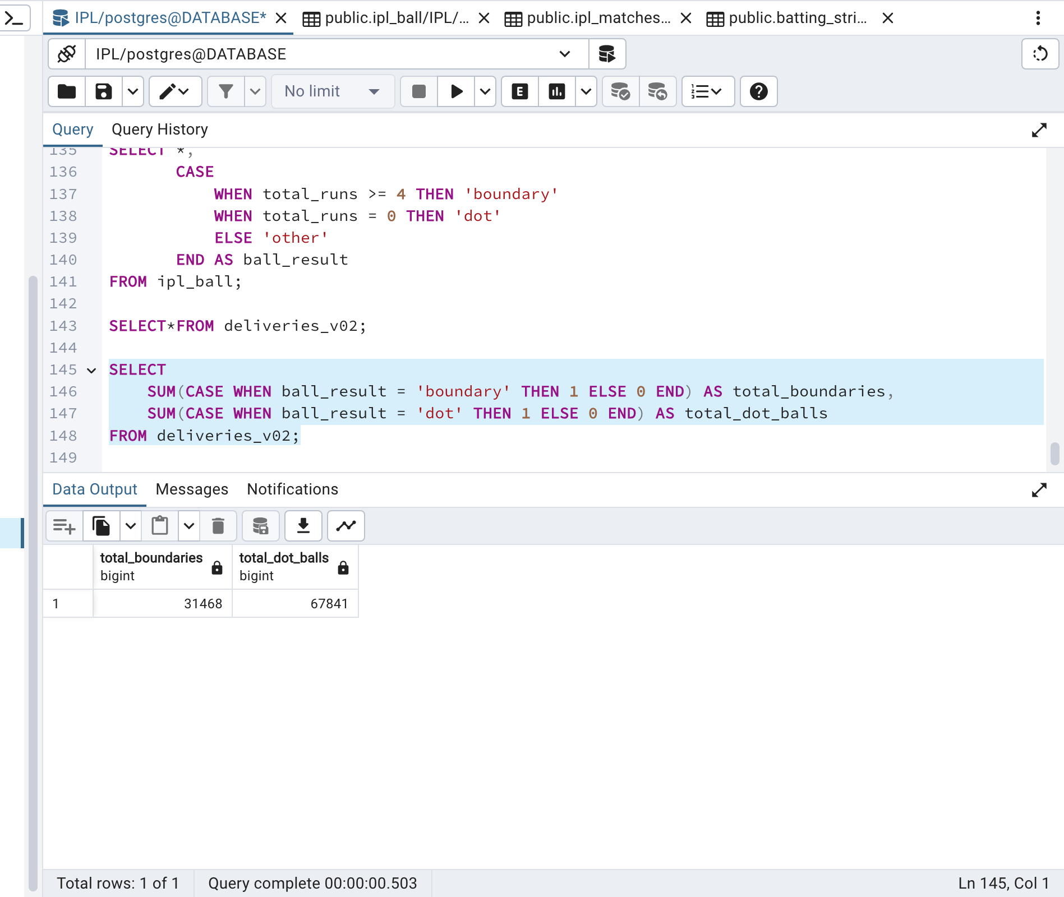
Write a query to fetch the total number of boundaries and dot balls from the deliveries_v02 table.

Slide 13
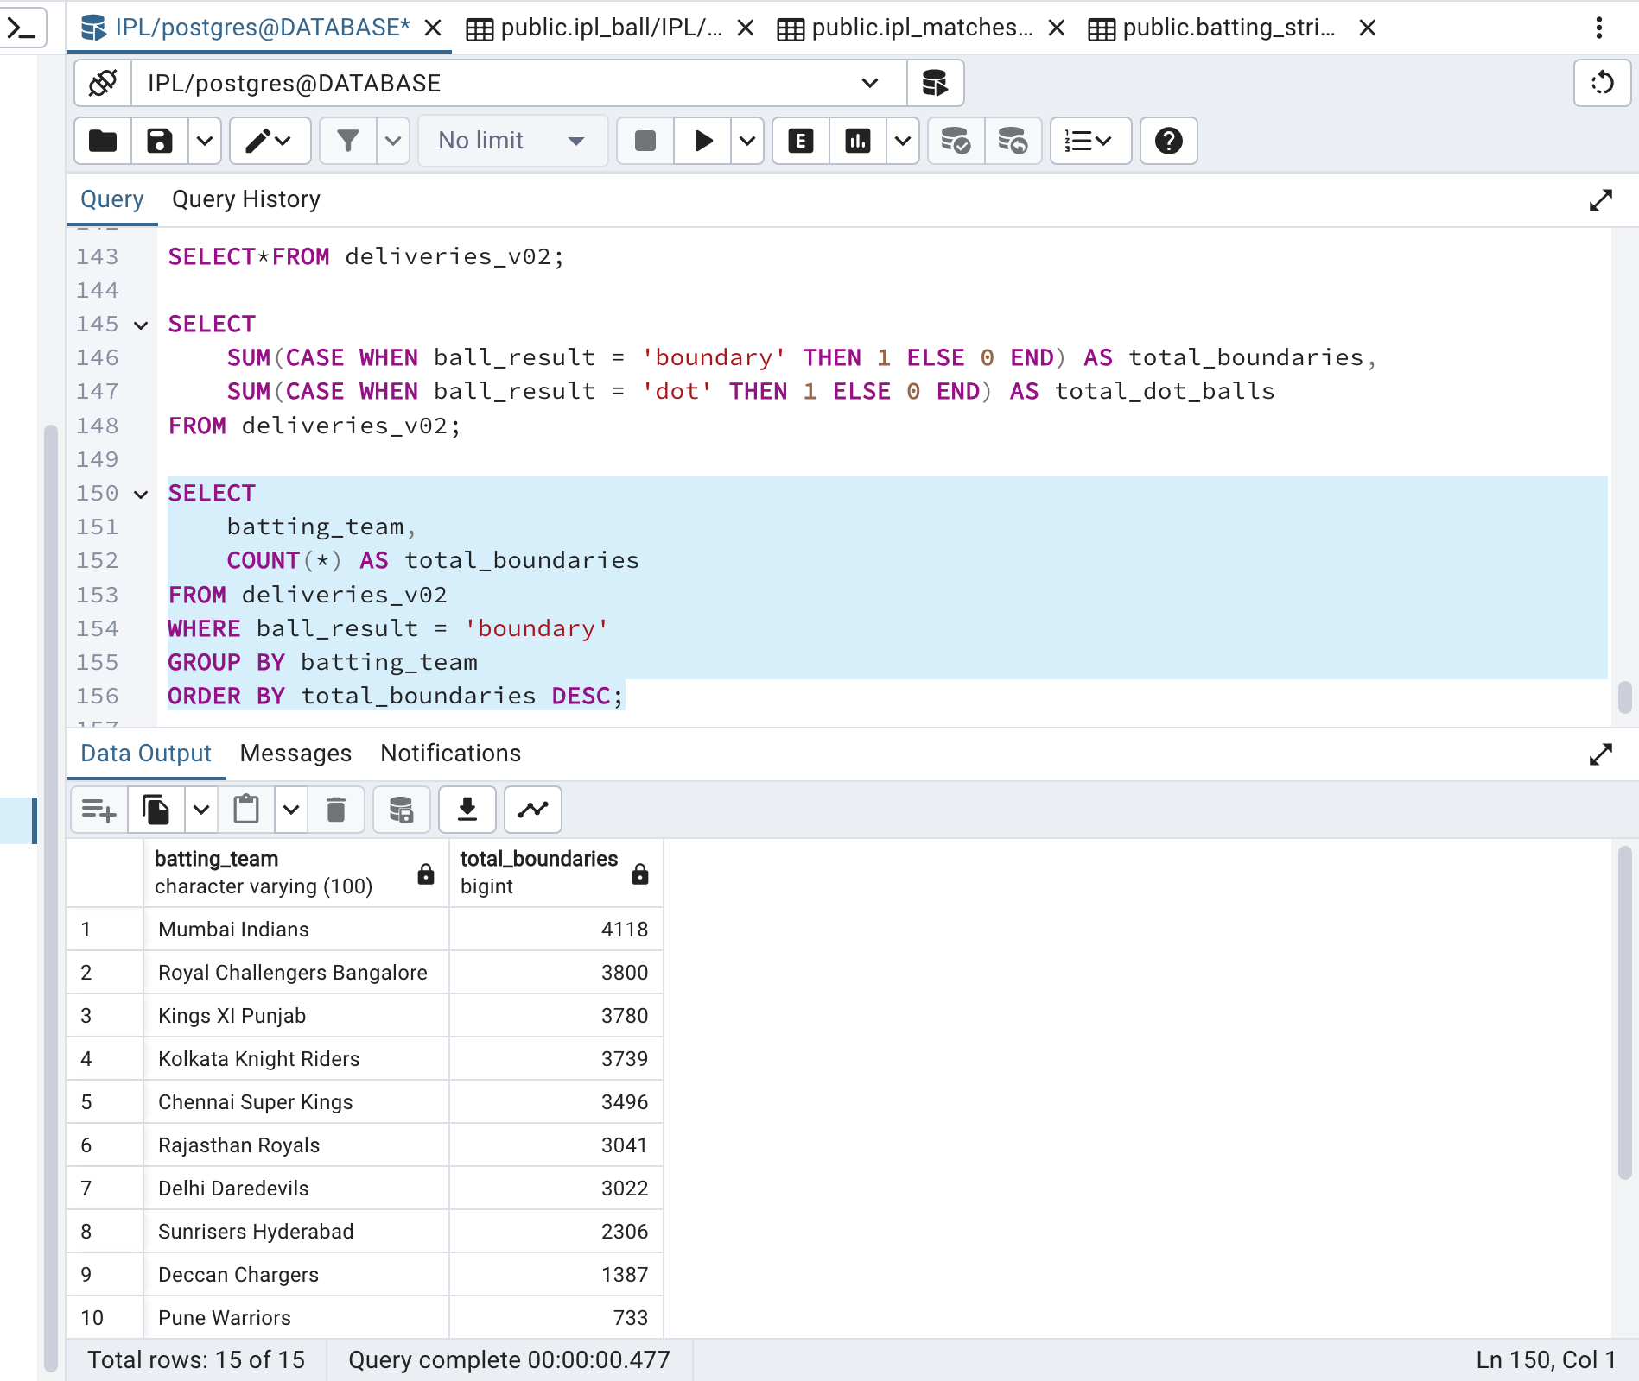
Write a query to fetch the total number of boundaries scored by each team from the deliveries_v02 table and order it in descending order of the number of boundaries scored.

Slide 14
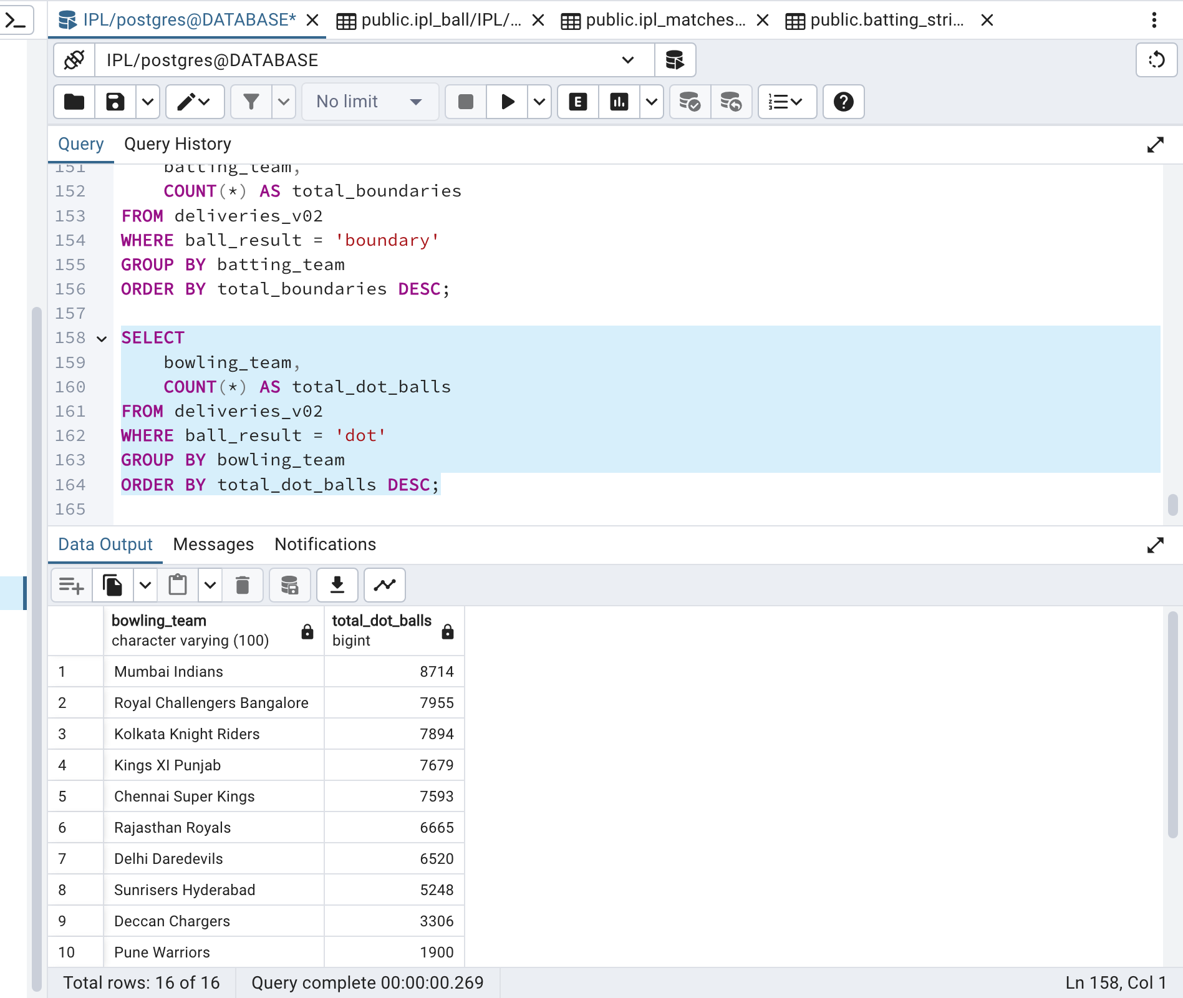
Write a query to fetch the total number of dot balls bowled by each team and order it in descending order of the total number of dot balls bowled.

Slide 15
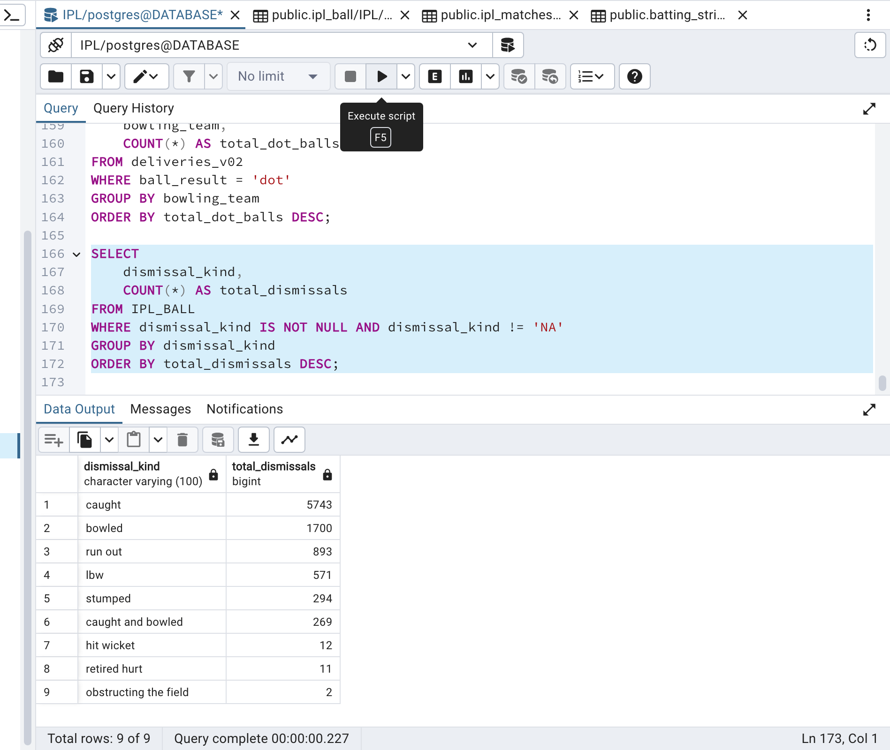
Write a query to fetch the total number of dismissals by dismissal kinds where dismissal kind is not NA

Slide 16
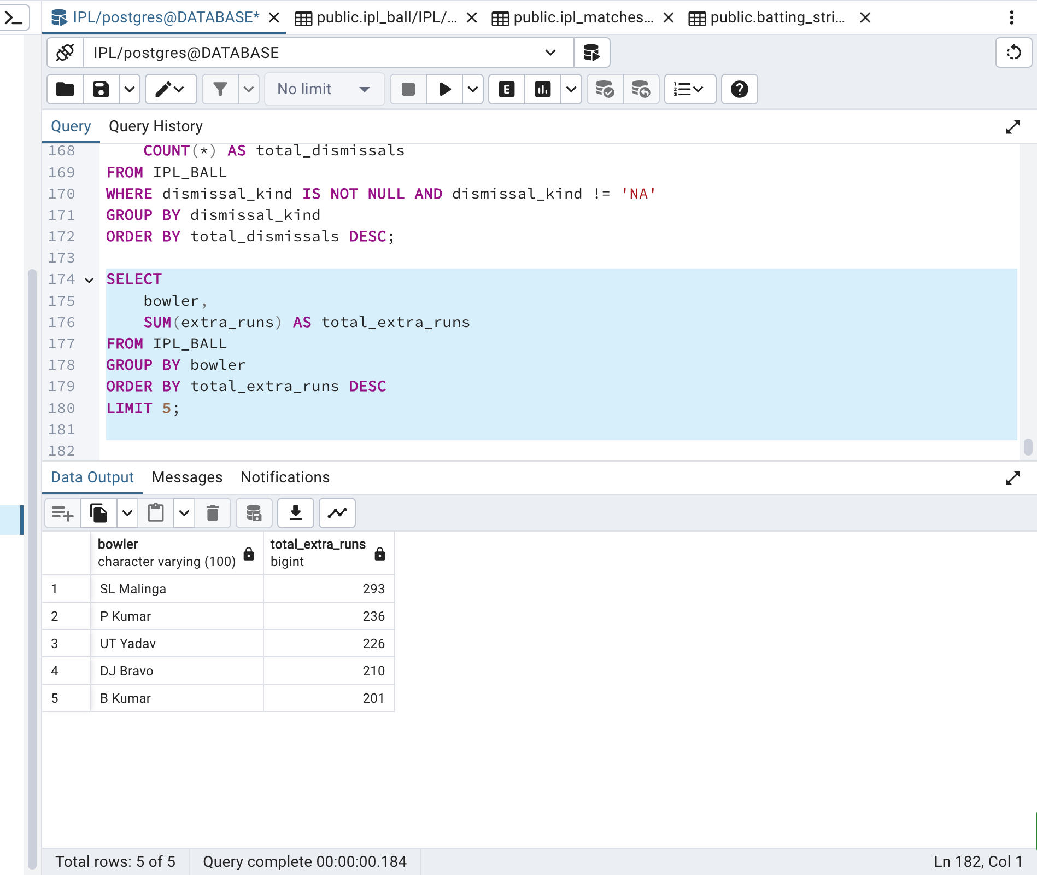
Write a query to get the top 5 bowlers who conceded maximum extra runs from the deliveries table

Slide 17
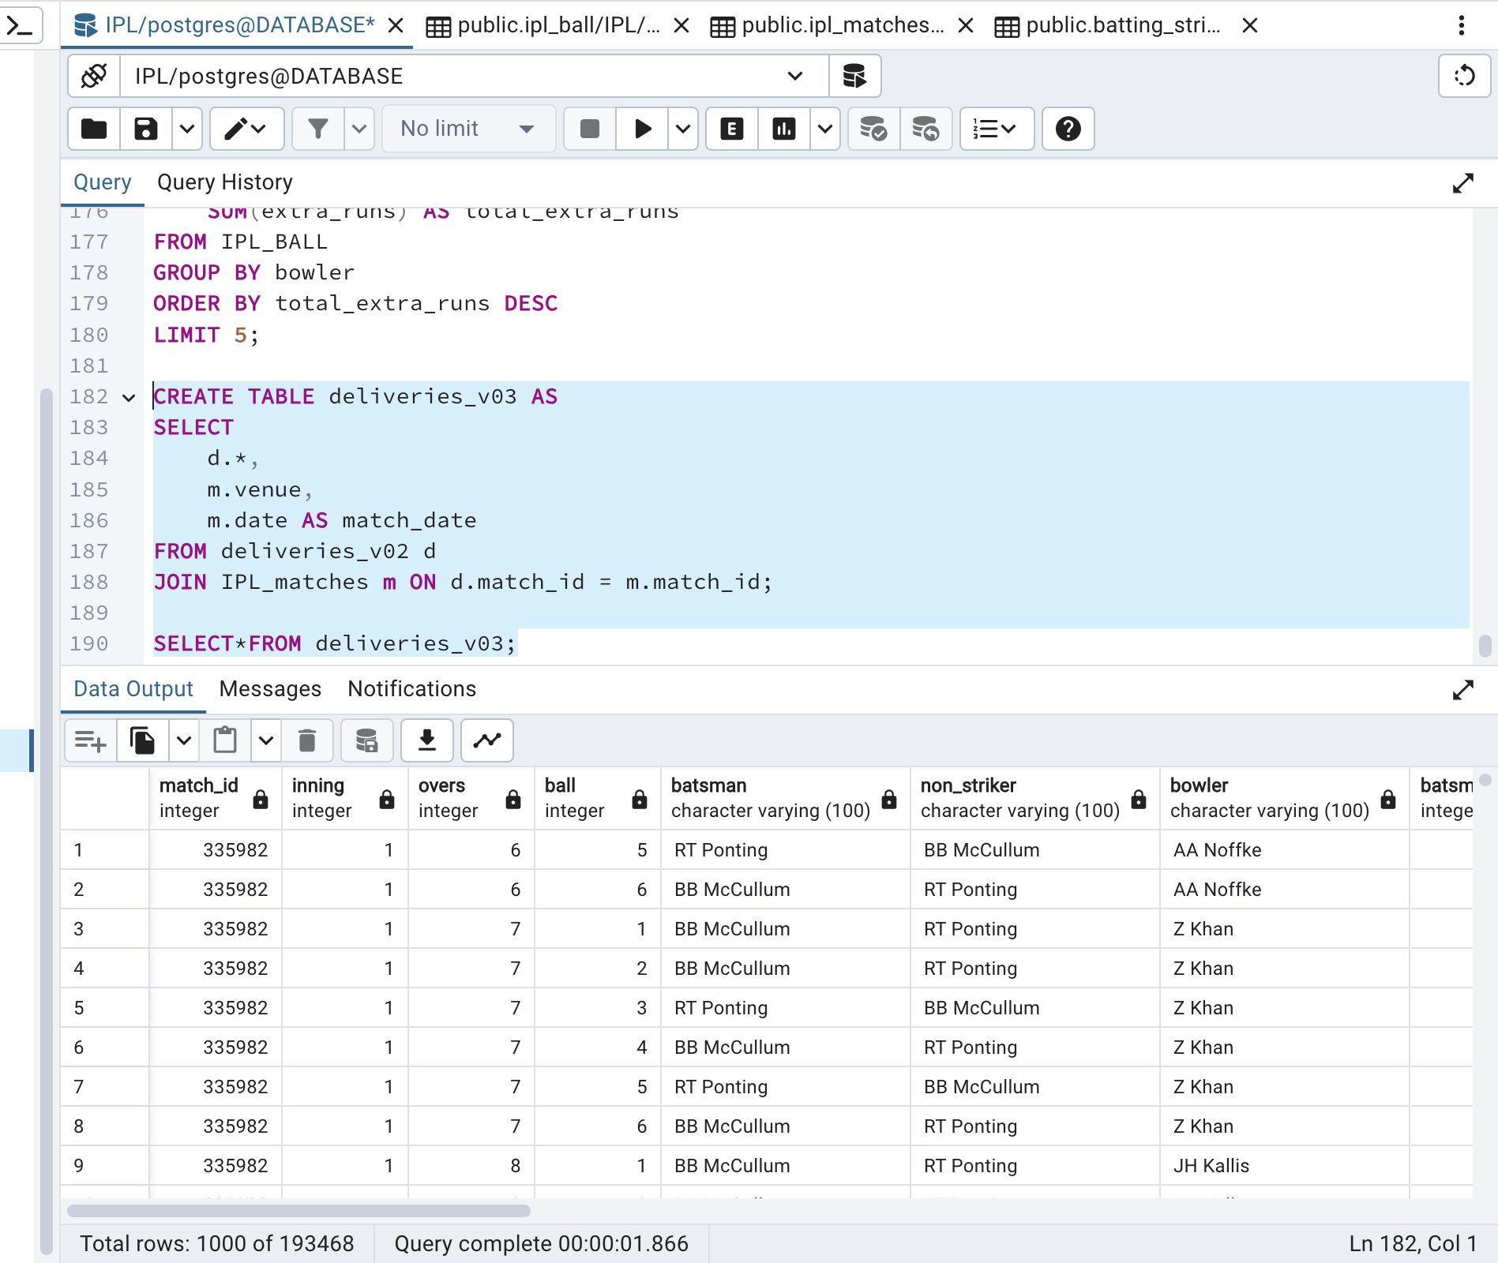
Write a query to create a table named deliveries_v03 with all the columns of deliveries_v02 table and two additional column (named venue and match_date) of venue and date from table matches

Slide 18
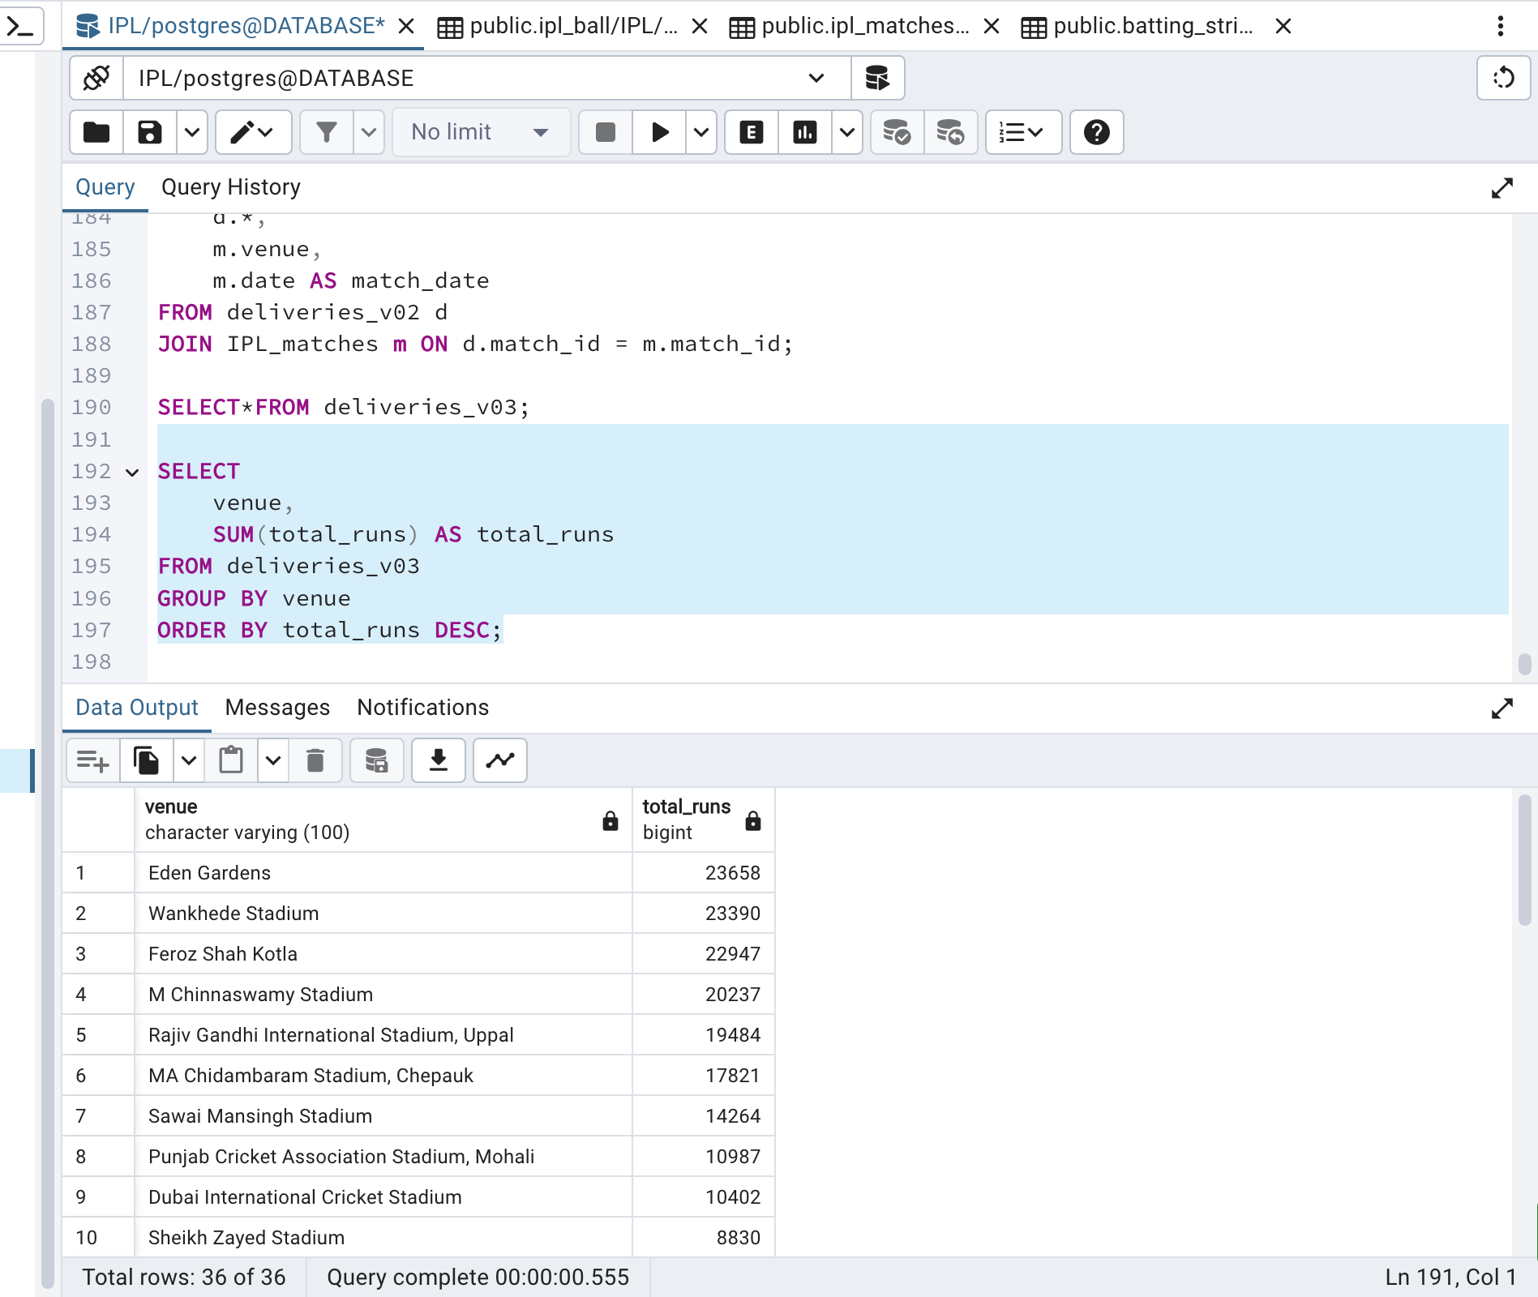
Write a query to fetch the total runs scored for each venue and order it in the descending order of total runs scored.

Slide 19
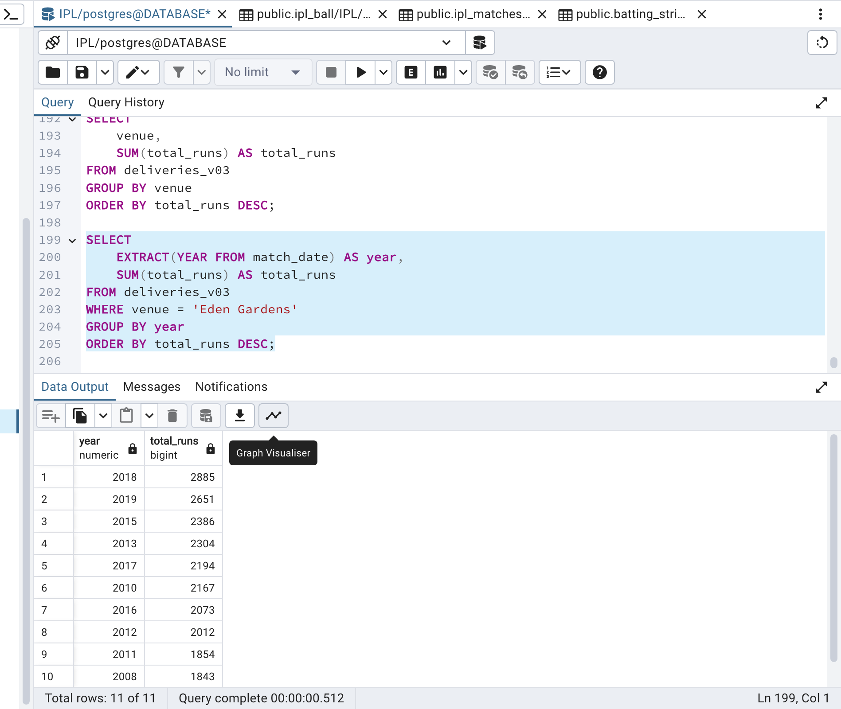
Write a query to fetch the year-wise total runs scored at Eden Gardens and order it in the descending order of total runs scored.

Slide 20
THANK YOU

